Slide 1


SDM INSTITUTE OF TECHNOLOGY, UJIRE (D.K)
MINI ANVESHANA 2024
Coin Separation Using DIP
Team Number : 30
Team Members :
1. Pratham H P
2. Sharath Krishna Naik
3. Rohan Kumar M S
Guide Name : Mr. Raghuveera Pandith

Slide 2
CONTENT
PROBLEM STATEMENT
SOLUTION
BLOCK DIAGRAMS
MARKET POTENTIAL
ADDITIONAL INFORMATION

Slide 3
PROBLEM STATEMENT
Manually separating coins in temples and banks is a time-consuming and labor-intensive process. Additionally, human intervention increases the likelihood of minor errors, resulting in inefficiencies.

Slide 4
SOLUTION
An effective solution is to develop an automated system that uses digital image processing techniques, such as edge detection and feature extraction, to distinguish and sort coins based on their distinct visual characteristics in captured images.

Slide 5
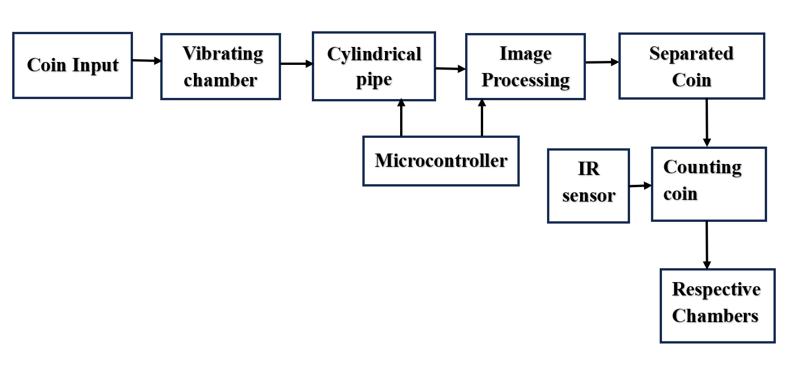
PROTOTYPE IMAGE

Slide 6
MARKET POTENTIAL
The market potential for an automated coin sorting system using digital image processing is significant, especially in Temples, banking, retail, where it can enhance sorting accuracy, reduce labor costs, and improve transaction efficiency.

Slide 7
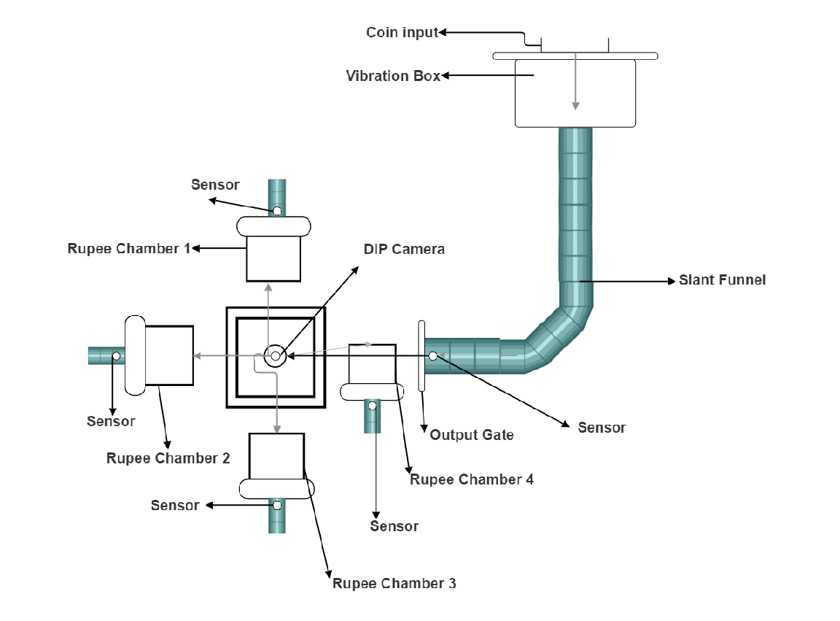
ADDITIONAL INFORMATION

Slide 8
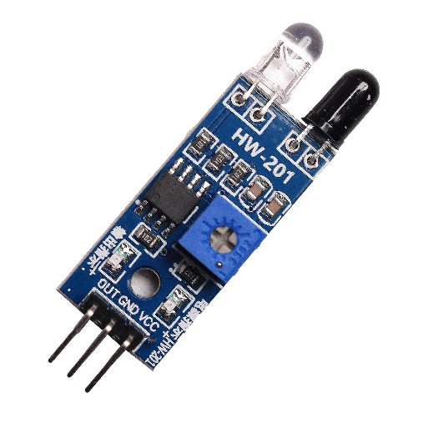
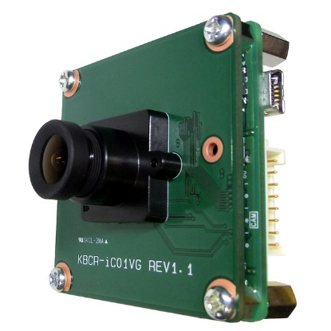
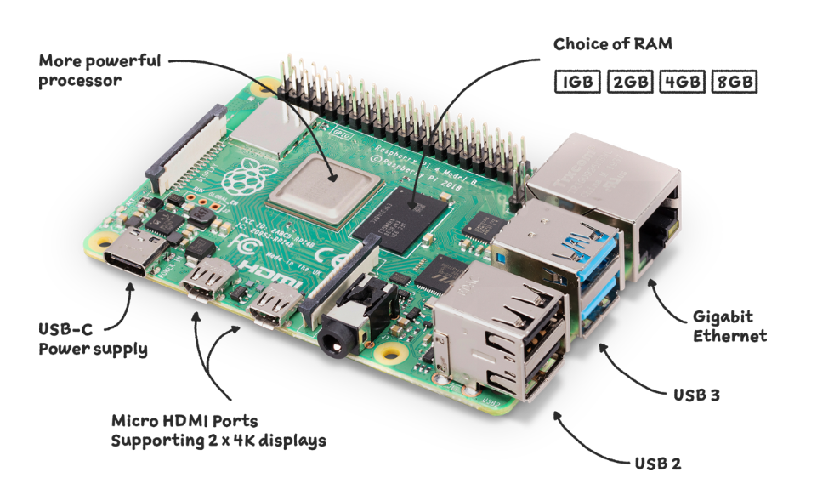
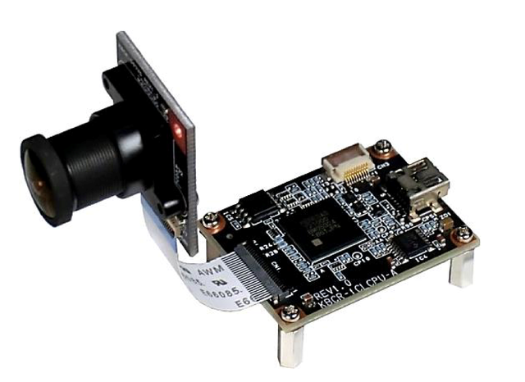
COMPONENTS
IR Proximity Sensor
Image processing camera
Raspberry-pi-4
Camera with Raspberry Pi

Slide 9
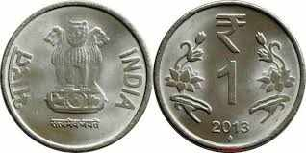
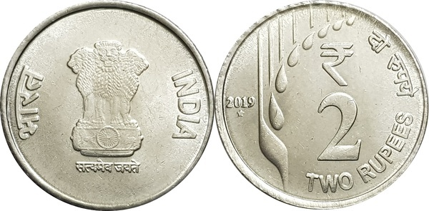
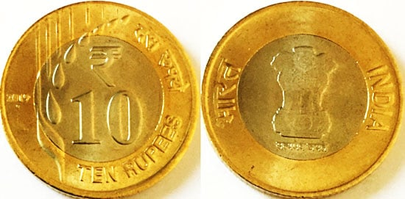
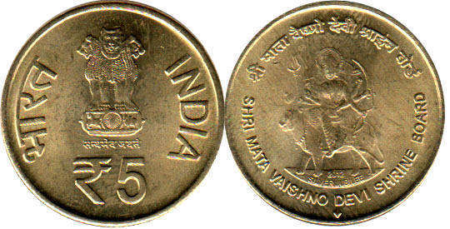







IMAGE PROCESSING OF COIN

Slide 10


Slide 11


